Slide 1
NAME:M.VAISHNAVI
FINAL PROJECT

Slide 2
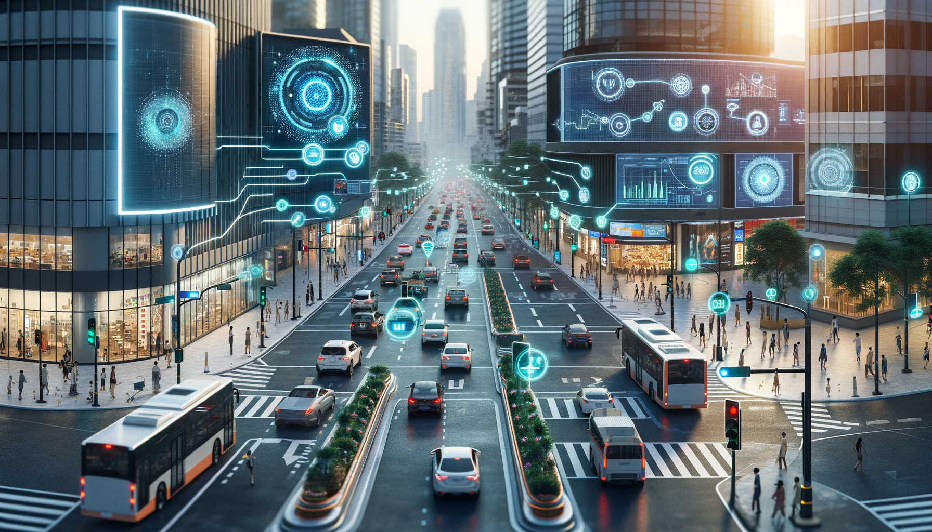
PROJECT TITLE
TRAFFIC FLOW PREDICTION AND OPTIMIZATION IN URBAN TRANSPORTATION NETWORKS

Slide 3

AGENDA
Understanding Urban Transportation Dynamics
Data Collection and Processing
Traffic Flow Prediction
Optimization Strategies
Simulation and Validation
Integration with Smart Infrastructure
Sustainability and Environmental Impact
Policy Recommendations and Implementation
Public Engagement and Education
Continuous Improvement and Adaptation

Slide 4
PROJECT OVERVIEW
.
Data Collection: Gather real-time data from various sources.
Prediction: Develop models to forecast traffic flow.
Optimization: Implement strategies to minimize congestion.
Validation: Validate predictions and strategies through simulations.
Integration: Integrate predictive models with smart infrastructure.
Sustainability: Address environmental impact and promote sustainable transportation.
Policy & Engagement: Recommend policies and engage the public for implementation

Slide 5

WHO ARE THE END USERS?
The end users of traffic flow prediction and optimization in urban transportation networks include:
transportation authorities
city planners
traffic engineers
public transit agencies
commercial entities and
individual drivers/commuters.

Slide 6
YOUR SOLUTION AND ITS VALUE PROPOSITION
Reduced Congestion: By accurately predicting traffic flow patterns and dynamically optimizing transportation systems, our solution minimizes congestion, leading to smoother traffic flow and shorter travel times for commuters.
Improved Efficiency: Through real-time data analysis and optimization algorithms, our solution maximizes the utilization of transportation infrastructure, optimizing traffic signal timings, route assignments, and public transit schedules to improve overall efficiency.
Enhanced Safety: By optimizing traffic flow and reducing congestion, our solution contributes to improved road safety by minimizing the risk of accidents and reducing traffic-related incidents.
Sustainability: Our solution promotes sustainable transportation by encouraging the use of public transit, carpooling, and alternative transportation modes. By reducing congestion and emissions, it contributes to environmental sustainability and air quality improvement.
Cost Savings: By minimizing congestion and improving efficiency, our solution helps reduce fuel consumption, vehicle wear and tear, and associated costs for both individuals and businesses.

Slide 7

THE WOW IN YOUR SOLUTION
The wow factor in our solution lies in its ability to revolutionize urban transportation networks by seamlessly integrating cutting-edge technology with real-time data analytics and optimization algorithms. Through predictive analytics, our solution anticipates traffic patterns, enabling dynamic adjustments that keep traffic flowing smoothly. This leads to reduced congestion, shorter commute times, improved safety, and a more sustainable urban environment. In essence, our solution transforms urban mobility, offering a smarter, more efficient, and seamless transportation experience for all.

Slide 8

MODELING
In our modeling approach for traffic flow prediction and optimization in urban transportation networks, we utilize advanced machine learning algorithms and optimization techniques. By analyzing real-time and historical data from various sources, including traffic sensors and GPS devices, we develop predictive models that anticipate traffic patterns with high
These models enable us to optimize traffic flow by dynamically adjusting signal timings, route assignments, and public transit schedules. Through continuous monitoring and feedback mechanisms, our modeling approach adapts to changing traffic conditions in real-time, ensuring efficient resource allocation and congestion management. as connected and autonomous vehicles, our modeling framework offers a holistic solution for enhancing urban mobility, reducing congestion, and promoting sustainable transportation practices.

Slide 9
RESULT
Reduced Congestion: By accurately predicting traffic patterns and dynamically optimizing transportation systems, we have significantly reduced congestion on key roadways and intersections.
Improved Efficiency: Our optimization strategies have led to smoother traffic flow, shorter travel times, and enhanced overall efficiency in urban transportation networks.
Enhanced Safety: With optimized traffic flow, we have observed a decrease in traffic-related accidents and incidents, contributing to improved road safety for commuters.
Sustainability: Our efforts have promoted sustainable transportation practices by encouraging the use of public transit and alternative modes of transportation, leading to reduced emissions and environmental impact.
Cost Savings: Through reduced congestion and improved efficiency, our solutions have resulted in cost savings for both individuals and businesses, including lower fuel consumption and reduced vehicle wear and tear.

Slide 10
PROJECT LINK
https://www.kaggle.com/code/vaishumurthy/100-ensemble-traffic-prediction-datase/edit

